Slide 1



Introduction to Database Systems
Sistem Basis Data
Rizka Wakhidatus Sholikah

Slide 2



Outline
What is database?
What is Database Management Systems (DBMS)?
Type of Database
Functions of DBMS
Advantages of DBMS
Disadvantages of DBMS
www.its.ac.id
INSTITUT TEKNOLOGI SEPULUH NOPEMBER, Surabaya - Indonesia

Slide 3
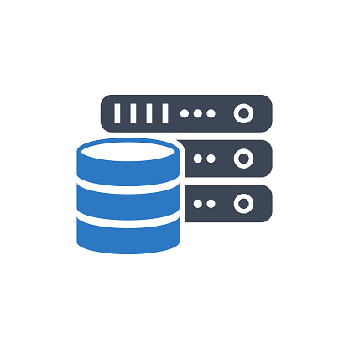
What is database?
Database
An integrated computer structure that stored a collection of data
Consist of two types of data:
End-user data (raw data)
Metadata
Metadata
Data about data
Describe data characteristics and the set of the relationships that links the data found within the database
www.its.ac.id
INSTITUT TEKNOLOGI SEPULUH NOPEMBER, Surabaya - Indonesia

Slide 4

Metadata
Book has a number of standard metadata:
Title
Author name
Publisher
Page number
www.its.ac.id
INSTITUT TEKNOLOGI SEPULUH NOPEMBER, Surabaya - Indonesia

Slide 5

Can you identify some of the data generated by your daily activity that stored into database?
www.its.ac.id
INSTITUT TEKNOLOGI SEPULUH NOPEMBER, Surabaya - Indonesia

Slide 6
Database Management Systems (DBMS)
DBMS
Software that manages the database structure and controls access to the data stored in the database
Interface between end-user and the database
The DBMS receives all application requests and translates them into the complex operations required to fulfill those requests
www.its.ac.id
INSTITUT TEKNOLOGI SEPULUH NOPEMBER, Surabaya - Indonesia

Slide 7
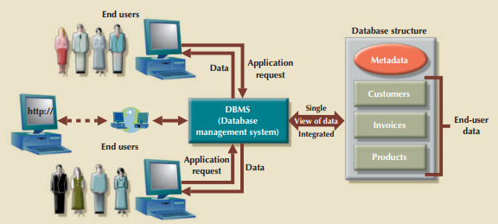
DBMS
www.its.ac.id
INSTITUT TEKNOLOGI SEPULUH NOPEMBER, Surabaya - Indonesia

Slide 8
Type of database
Based on number of users:
Single-user database
Support only one user at a time
Multiusers database
Support multiple user at the same time
Multiusers consist of two types:
Workgroup database
Number of users < 50
Enterprise database
Number of users > 50
www.its.ac.id
INSTITUT TEKNOLOGI SEPULUH NOPEMBER, Surabaya - Indonesia

Slide 9
Type of database
Based on locations:
Centralized database
A database located at the single site
Distributed database
A logically related database that is stored in two or more physical independent sites
Cloud database
Database that maintain by cloud services, Microsoft Azure, Google Cloud, Amazon AWS
Note:
Both centralized and distributed database required a well-defined infrastructure
Cloud database do not need to build the infrastructure
www.its.ac.id
INSTITUT TEKNOLOGI SEPULUH NOPEMBER, Surabaya - Indonesia

Slide 10
Type of database
Based on data stored inside database:
General purpose database
Contains wide variety of data used in multiple discipline
Discipline-specific database
Contains data focused on specific subject area
Example: data for academic purpose
www.its.ac.id
INSTITUT TEKNOLOGI SEPULUH NOPEMBER, Surabaya - Indonesia

Slide 11
Function of DBMS
Data dictionary management
Store data element and relationships
Used data dictionary to look up the requires data component structured and relationships
Data storage management
DBMS creates and manages complex structures required for data storage
Data transformation and presentation
DBMS transforms the data to conform to required data structures
Security management
Creates security systems that enforces user security and data privacy
Multiuser access control
uses sophisticated algorithms to ensure that multiple users can access the database concurrently without compromising its integrity
www.its.ac.id
INSTITUT TEKNOLOGI SEPULUH NOPEMBER, Surabaya - Indonesia
Notes:
Data dictionary: a dbms component that store the metadata

Slide 12
Function of DBMS
Backup and recovery management
provides backup and data recovery to ensure data safety and integrity
Data integrity management
promotes and enforces integrity rules, thus minimizing data redundancy and maximizing data consistency
Data access languages and application programming interfaces
The DBMS provides data access through a query language
Data communication interfaces
A current-generation DBMS accepts end-user requests via multiple, different network environments
www.its.ac.id
INSTITUT TEKNOLOGI SEPULUH NOPEMBER, Surabaya - Indonesia
Notes:
Data dictionary: a dbms component that store the metadata

Slide 13
Advantages of DBMS
Improve data sharing
Enables data in the database to be shared among multiple applications or users
Improve data security
Provides a framework for better enforcement of data privacy and security policies. Only required user can access the database
Better data integration
Have access to well managed and synchronized form of data, give view of integrated system in an organizations
Minimize data inconsistency
Database ensure the consistency and non redundancy of data
www.its.ac.id
INSTITUT TEKNOLOGI SEPULUH NOPEMBER, Surabaya - Indonesia

Slide 14
Advantages of DBMS cont.
Improve data access
Makes it possible to produce quick answers of query
Improve decision making
Better-managed data and improve data access lead to generate better-quality of information
Increase end-user productivity
empowers end users to make quick, informed decisions
www.its.ac.id
INSTITUT TEKNOLOGI SEPULUH NOPEMBER, Surabaya - Indonesia

Slide 15
Disadvantages of DBMS
Increased cost
Database systems require sophisticated hardware and software and highly skilled personnel.
The cost of maintaining the hardware, software, and personnel required to operate and manage a database system can be substantial
Management complexity
The changes introduced by the adoption of a database system must be properly managed
Maintaining currency
Keep the system current
updates and apply the latest patches and security measures to all components
Frequent upgrade/ replacement cycles
DBMS vendors frequently upgrade their products by adding new functionality
Sometimes lead to upgrade the hardware
www.its.ac.id
INSTITUT TEKNOLOGI SEPULUH NOPEMBER, Surabaya - Indonesia

Slide 16
Question?
www.its.ac.id
INSTITUT TEKNOLOGI SEPULUH NOPEMBER, Surabaya - Indonesia

Slide 17
Thank you

